Slide 1



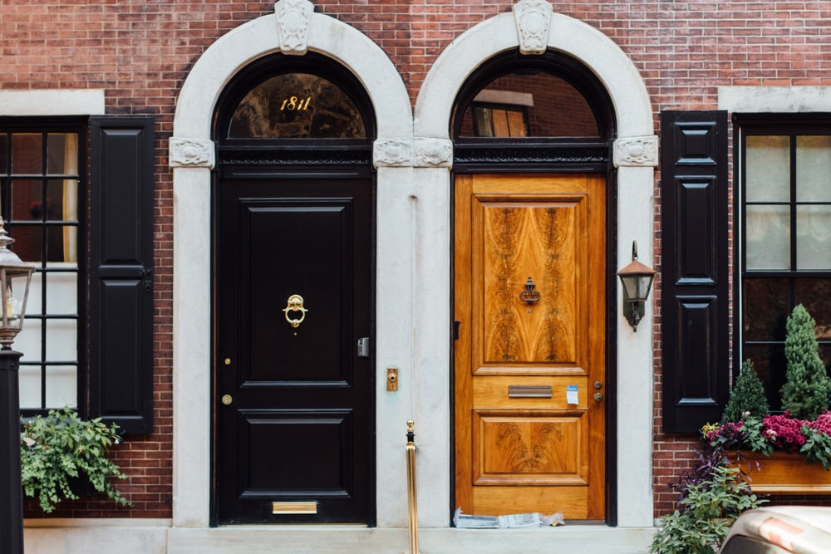






Roomer
Roomer
find your
buyer here.
find your
buyer here.
Search…
HOUSE | $500 - $700 | Provo UT | October 22, 2021
Hi! My name is Sandra. I’m looking
for something small and price friendly….
I’m looking for a place
Gym
Pool
APARTMENT | $200 - $500 | Orem UT | December 1, 2021
Hello, I’m Craig. I’m a functional dude
who just needs some peace and quiet…
Filter buyer listings…
HOUSE | $500 - $700 | Provo UT | October 22, 2021
Hi! My name is Sandra. I’m looking for something small and price friendly….
Dog
Private
Room
Yard
HOUSE | $1000 - $1500 | Orem UT | January 23, 2022
Hey I’m Mandy. I’m looking for
something on the nicer side…
House
Gym
Pool
Apartment
APARTMENT | $200 - $500 | Orem UT | December 1, 2021
Hello, I’m Craig. I’m a functional dude who just needs some peace and quiet…
Pool
$100
$5,000
I have a place in…
Dog
Private
Room
Yard
I’m trying to sell by…
HOUSE | $1000 - $1500 | Orem UT | January 23, 2022
Hey I’m Mandy. I’m looking for something on the nicer side…
Pool

Slide 2
Roomer
Sign in with Facebook
Sign in with Google
Username
Password

